Slide 1

Web scraping to gain company insights
Athulya M Aspiring Data Analyst

Slide 2
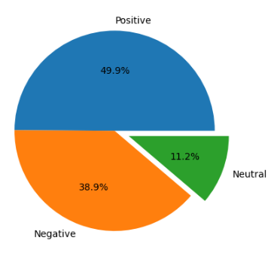
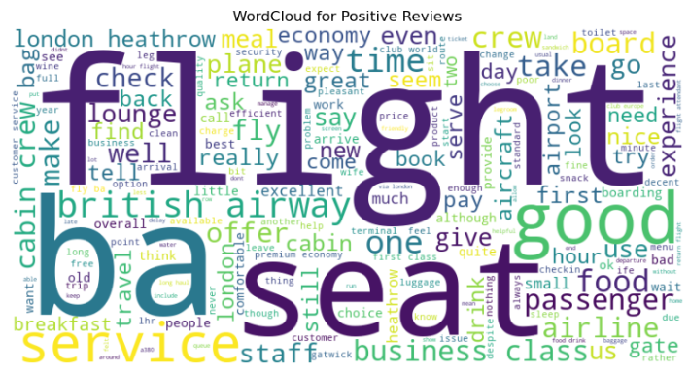
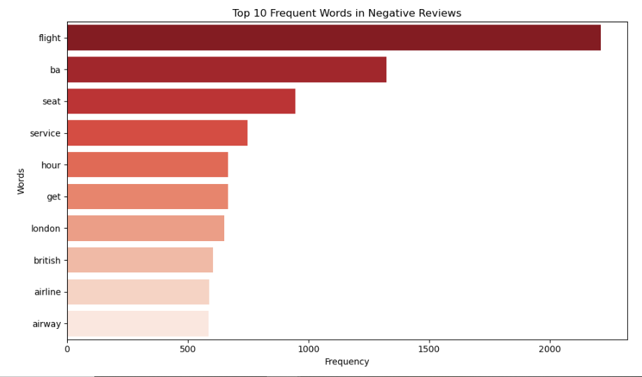
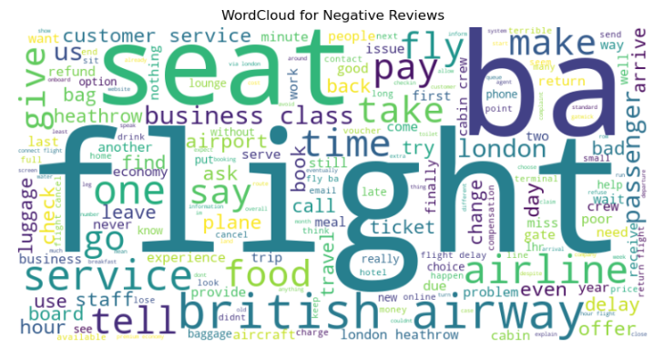
Insights from Customer Reviews
From cleaning 2416 reviews given by the customers, we obtained
Positive Reviews - 1205
Negative Reviews - 939
Neutral Reviews – 271

